Slide 1
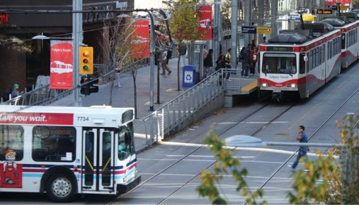
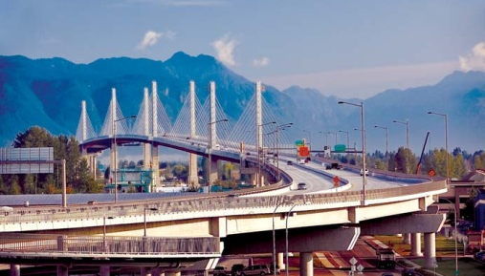
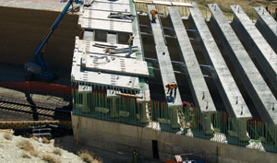
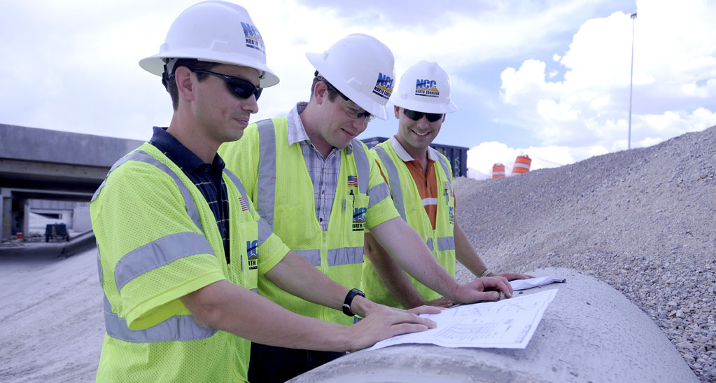
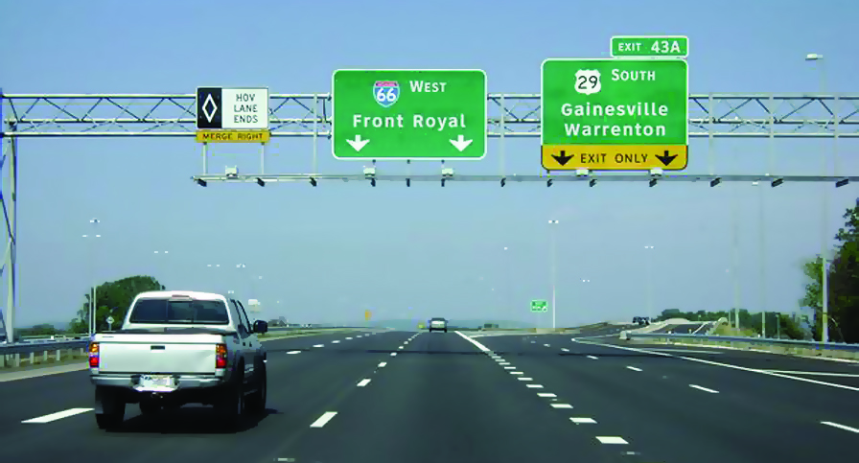
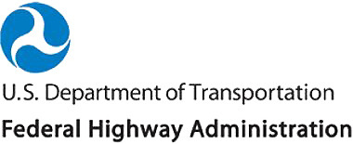
Operations in the 21st Century DOT
Meeting Customers Needs
And Expectations
Notes:
Description of the Slide
Cover: This presentation is geared towards DOT executives regarding the increasingly important role of transportation systems management and operations (TSMO) – hereinafter simply referred to “operations” – in the effective management and delivery of transportation services to DOT’s customers. In other words – how operations can help DOTs to meet their customer needs and expectations in a rapidly changing environment.
Key Points
Hello and thank you for taking time from your busy schedule(s) to discuss transportation system management and operations, what operations can do to help DOT improve customer service, and some actions you can take to improve operations in your agency
Introductions
Other - Depending on the audience and time, considerations should be given to prompting the audience to ask questions at any time during the presentation.
SLIDE 1: Operations in the 21st Century DOT

Slide 2
Purpose of This Meeting: Share Thoughts & Discuss
Challenges brought about by the changing transportation environment and public (i.e., “customer”) expectations
How operations and supporting technologies can help address these issues
Importance of mainstreaming operations into the DOT’s program (and the transportation planning process)
Notes:
Description of the Slide
Our presentation and discussions today will focus on three key areas as shown here.
Key Points
The role of the a DOT has evolved over the past 75 years in response to the changing needs of customers. From an initial mandate that centered around building and preserving the transportation infrastructure, the transportation environment has changed such that a DOT’s responsibilities have expanded To also include actively managing and operating the network as effectively as possible so as to meet customers’ demands for safety, mobility, and reliability; and to do so in the most cost-effective manner.
Operations and the supporting technologies are valuable tools for meeting these challenges and optimizing the transportation system.
Operations cannot succeed in a vacuum – it must be understood and become a core function throughout the agency; in other words, operations must be mainstreamed into the entire DOT programming and planning processes.
SLIDE 2: Purpose of This Meeting: Share Thoughts & Discuss

Slide 3
What is Operations?
Transportation Systems Management and Operations (TSMO, TSM&O)
Defined in MAP 21
“Integrated strategies to optimize the performance of existing infrastructure through the implementation of multimodal and intermodal, cross-jurisdictional systems, services, and projects”
Supported and enabled by Intelligent Transportation System (ITS) technologies
Notes:
Description of the Slide
Before getting into any more discussions, it is perhaps worthwhile to define just what is meant by “operations”.
Key Points
The current federal transportation reauthorization – Moving Ahead for Progress in the 21st Century Act, or MAP 21 – defines “Transportation Systems Management and Operations”
A key phrase in this definition is the notion of “integrated strategies.” The goal of integration is to bring the management and operation of the surface transportation network into a unified whole, thereby making the various transportation modes and facilities perform better and work together.
There are many aspects of integration – for example:
Technical integration in terms standards and system architectures that support information sharing between ITS-based systems; and also
Institutional integration such that operations are mainstreamed into a transportation agency’s institutional framework and corresponding business processes; and also coordination and collaboration between various agencies and jurisdictions in the region to achieve seamless interoperability
Other - MAP-21 expires in September, 2014. The presenter should check the subsequent re-authorization for any change in the definition of TSMO or emphasis.
SLIDE 3: What is Operations?

Slide 4
Example Operations Strategies and Solutions
Work Zone Management
Traffic Incident Management
Service Patrols
Special Event Management
Road Weather Management
Transit Management
Traffic Signal Coordination
Traveler Information
Ramp Management
Managed Lanes
Active Traffic Management
Integrated Corridor Management
More discussion of some of these and their benefits later
Notes:
Description of the Slide
This slide lists several of the operations strategies that’s have been applied by DOTs and transportation agencies across the country; and in doing so, they have made substantial positive impact on the safety, mobility, and reliability of the surface transportation network.
Key Points
Operations consists of a wide array of possible strategies and opportunities, from every-day activities to cutting edge solutions and technologies.
Many of these strategies can be applied to both urban and rural environments.
We will touch on some of these in more detail, including potential benefits later.
Other - If possible, perhaps highlight a few of these strategies in terms of what the specific DOT has done / is doing.
SLIDE 4: Example Operations Strategies and Solutions

Slide 5
The Transportation Environment is Changing
Increased reliance on information and technology
Increasing customer needs and expectations
Growing emphasis on measuring performance
Reduced financial resources
Technology also offers opportunities – multiple operations strategies and regional integration of various modes
Notes:
Description of the Slide
It should come as no surprise to you that the transportation environment in which DOT’s conduct their business has been and continues to change, often quite rapidly.
Key Points
We are living in an information revolution, brought about and supported by new and emerging technologies. In today’s connected world, customers are regularly introduced to new ways of obtaining and using real-time information to save time and money; and DOTs are expected to take advantage and use these technologies.
The DOT’s customers – that is, the traveling public – expect that the products they use and the technologies they encounter will be “smart” and will ultimately improve their travel experience, They also expect that the information received will be accurate and reliable—regardless of who “owns” the road or the information.
There is also an increased emphasis on accountability and transparency on how DOTs conduct their business; and this requires that the performance of the transportation network be regularly measured and compared to established metrics.
Moreover, the increased expectations and accountability are coming at a time when government agencies are expected to do more, but with fewer financial resources.
These same technologies can also help DOTs meet these increased expectations through the execution of operations strategies. However, it is important to remember that operations is more than merely implementing technology along the roadway.
Other - The key points listed above are for a shorter version. If a longer version is being presented (including the next 4 slides), then the key points can be skipped, and lead into the next slide with “there are several reasons behind this changing environment”
SLIDE 5: The Transportation Environment is Changing

Slide 6
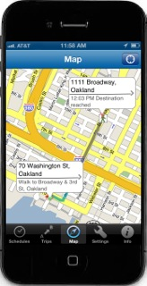
Technology is Transforming
Our World
Increased availability of information
Internet connectivity, wireless communications, cloud computing
Information is available 24/7 on mobile devices
Customers’ perception: technology can improve efficiency and service
The future – even more innovative technologies and a shorter shelf life
New data services
Connected / autonomous vehicles
From 511SF web site
Notes:
Description of the Slide
We are living in an information revolution. The internet and wireless communications, coupled wide-spread use of mobile devices and related technologies, have transformed the way business is done and how value is delivered.
Key Points
In today’s connected and information-rich world, customers are regularly introduced to new ways of using real-time information to save time and money; and DOTs are expected to take advantage of and use technology to improve efficiency and service.
The DOT’s customers – that is, the traveling public – expect that the products they use and the technologies they encounter will be “smart” and will ultimately improve their travel experience, They also expect that the information received will be accurate and reliable—regardless of who “owns” the road or the information.
Moreover, technology will likely have an even greater impact on the transportation network in the future. We are watching a new era of transportation emerge through the Connected Vehicle program that that allows cars and infrastructure to communicate with one another. And a week doesn’t pass with out some news article on the future of autonomous vehicles. How these future technologies may impact how we manage and operate the transportation network is mind-boggling.
SLIDE 6: Technology is Transforming Our World

Slide 7
Customer Expectations and Needs are Changing
Public’s expectations of government
Increased productivity and efficiency
Greater demand for accountability – value expected from the use of tax and toll dollars
Improved performance and service for commuter, freight, recreational, and other trips:
Mobility including reduced delays and congestion
Safety
Accurate, timely, and accessible information
Reliability (a focus of SHRP 2 program)
Notes:
Description of the Slide
As already noted, advances in technology and the availability of real-time information have increased DOT’s customers’ expectations.
Key Points
Technology has been harnessed by the private sector to improve productivity; and the same is expected (and is well underway) for government entities.
A part of these increased expectations is a greater demand for accountability – that customers are receiving value for their tax dollars and tolls.
Additionally, DOT customers are expecting improvements in mobility, safety, information, and reliability.
With respect to the last point; congestion is an accepted and even predictable reality in major urban areas. So the real source of frustration for users and lost productivity for businesses comes from unexpected delays that are encountered because of crashes, special events, unanticipated work zones, extreme weather, and the like. The reliability of the transportation system has come to be at least as important as travel time itself.
Other - There is a “reliability” slide in the “parking lot” at the end of the presentation, and can be used next if the audience may not be aware of what the term “reliability” actually means.
SLIDE 7: Customer Expectations and Needs are Changing

Slide 8
Performance Measures
Element of increased accountability
“The game gets serious when you start to keep score!”
Emphasized in MAP 21
Goals and associated measures being established for:
Safety
Infrastructure Condition
Congestion Reduction
System Reliability
Freight Movement and Economic Vitality
Environmental Sustainability
Reduced Project Delivery Delays
Notes:
Description of the Slide
The increased emphasis on government accountability and transparency has focused more attention on measuring and reporting on performance. MAP-21 and FHWA emphasize the use of measureable objectives and associated performance metrics.
Key Points
Performance measurement for transportation has been gaining traction the past several years. In essence
If you don’t measure results, can’t tell success from failure.
If you can’t see success, can’t reward it.
If you can’t see failure, can’t correct it.
In other words, you can’t manage it unless you measure it!
Under the requirements of MAP 21, we are beginning the process of “keeping score”. Goals and associated performance measures are being developed for several transportation categories.
Other -Prior to the presentation, the presenters should check on the current status of the effort to develop and publish (e.g., in the Federal Register for comment) the performance measures being developed by FHWA under the MAP 21 requirement.
SLIDE 8: Performance Measures

Slide 9
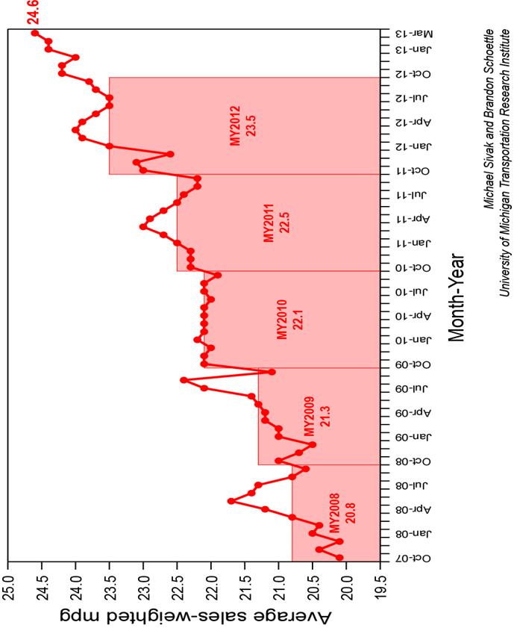
Increasing Financial Constraints
Decreasing fuel tax revenues going into Trust Fund
No change in the federal gas tax since 1993
Predictions that fund will become insolvent soon
Increased fuel efficiency
New CAFE standards
Emerging fleet of electric vehicles and plug-in hybrids pay no fuel tax
MUST DO MORE WITH LESS
Average Sales Weighted MPG
2008 - 2012
Notes:
Description of the Slide
The need to meet growing customer expectations for mobility and safety, increased accountability, and the associated performance management requirements is occurring at a time of reduced financial resources for most DOTs.
Key Points
The Highway Trust Fund, which was so instrumental in the construction of the Interstate Highway System and other transportation improvements, is running out of money, with current predictions that the transportation fund will become insolvent next year, if not sooner.
There are several reasons for this
The last increase in the federal gas tax was over 20 years ago, and inflation has significantly reduced its purchasing power.
Cars have become more fuel efficient, and will continue to do so in accordance with current Corporate Average Fuel Economy (CAFE) standards (average 35.5 mpg in 2016; average 54.4 mpg in 2025). This means less tax paid per miles driven, with electric vehicles paying no gas tax at all.
Technology allows many of us to be virtual commuters. The recent recession and high gas prices also reduce the amount of driving, further reducing the amount of gas tax taken in.
Several initiatives are underway to find a long-term solution to the declining gas tax revenues; but for the foreseeable future, many DOT’s will likely need to do more and satisfy rising customer expectations with less.
Other - It would be worthwhile to determine the state gas tax where the DOT is located, the history of increases, and any initiatives underway to provide a more sustainable funding mechanism.
SLIDE 9: Increasing Financial Constraints

Slide 10
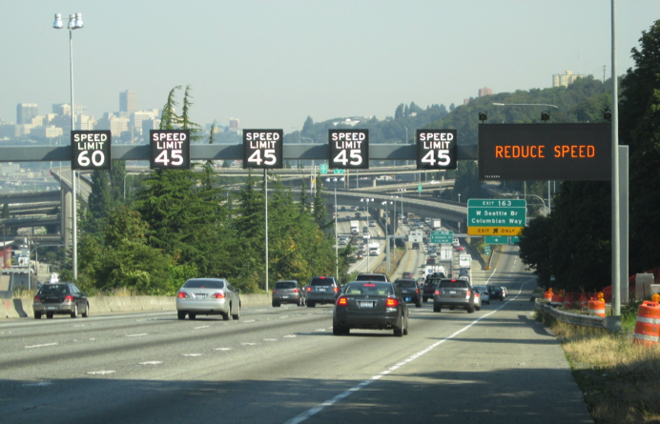
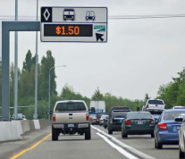
Operations Can Help Address These Challenges
Leverage Technology
Preserve and maximize existing capacity
Enhance safety
Promote mobility and customer outreach
Improve reliability for commuters and freight
Manage bottlenecks
Monitor performance
Implement quickly at relatively low cost
Notes:
Description of the Slide
Given the many challenges facing DOTs – increased customer expectations and accountability, financial constraints, and the limitations on the provision of significant new capacity – it is increasingly important to leverage technology and operate the existing network to its fullest service potential, essentially “taking back” the available capacity lost to congestion, incidents, construction, weather, etc. A robust transportation systems management and operations program can help a DOT to address all of these challenges; turning them into opportunities for meeting customer needs in a cost-effective manner.
Key Points
A major selling point for an increased emphasis on operations is that these strategies and supporting ITS technologies go to the heart of what DOTs want and need to deliver today. Operations investments lead to:
More efficient and effective use of the existing capacity
A safer system for travelers and responders to traffic incidents,
Enhanced customer mobility and outreach via state-of-the-art technologies
More-reliable service for commuters and shippers, thereby enhancing economic competitiveness
And in many instances, the opportunity to alleviate bottlenecks without new construction (e.g., ramp metering, hard shoulder running)
The same data collected to support operations can also be used as part of a performance management program
The benefits from operations can happen more quickly than from planning for and building new lanes, at a relatively low cost with great benefit–cost ratios
SLIDE 10: Operations Can Help Address These Challenges

Slide 11
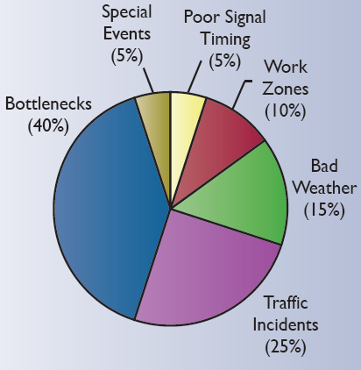
Traditional Approach to Managing Transportation
Causes of Congestion
(Source: FHWA)
Predict future (long range) traffic volumes
Fund major capital projects to provide additional capacity
This only addresses 40% of the congestion problem
Also becoming more and more difficult to provide new capacity
Notes:
Description of the Slide
Historically, DOTs have focused on relieving the causes of recurring congestion, such as bottlenecks and other capacity constraints. However, in large metropolitan areas over half of the total delay, and most of system unreliability, results from disruptions and incidents— what is referred to as non-recurring congestion – which is not substantially dealt with by adding new capacity
Key Points
The relationships among types and causes of congestion and mobility may not be widely appreciated.
The traditional approach of adding capacity to meet current and future demands only addresses part of today’s mobility, reliability and safety issues.
Most congestion and delays are the result of “non-recurrent” causes as shown, such as crashes, weather, and construction activities – events that additional capacity does not directly address.
Additionally, it is becoming more difficult to provide new capacity given current financial constraints and environmental concerns.
SLIDE 11: Traditional Approach to Managing Transportation

Slide 12
Providing Effective, Safe and Reliable Transportation
Building the necessary infrastructure
Keeping in a state of good repair (maintenance & reconstruction)
Operating and managing the infrastructure on a day-to-day basis
Core competencies of every DOT; and have been for decades
Operations should become a formal core program along with construction and maintenance activities
New construction will continue to be important.
But we can’t build our way out of congestion!
05
Notes:
Description of the Slide
Providing an effective, safe, and reliable transportation network may be likened to a 3-legged stool, with each leg representing the DOT functions of building the necessary infrastructure, preserving that infrastructure through maintenance and reconstruction, and operating and managing it on a daily basis so the available capacity can be utilized to its fullest extent. The transportation network cannot effectively serve customer needs if any of these three legs is missing or is underemphasized (i.e., too short) relative to the others.
Key Points
There is no doubt that adding physical capacity to our transportation infrastructure through basic construction projects, and then preserving and rehabilitating this infrastructure to keep in a state of good repair, will remain significant missions for state DOTs. But we can’t build our way out of congestion.
Operations strategies and the supporting ITS technologies must therefore become a formal core program with the same emphasis in the planning and programming processes as the other two.
Other - It might be worthwhile to mention, if appropriate, that the SHRP2 effort has developed:
Products to improve the quality of decision making and shorten project delivery time for new construction.
Technologies and institutional solutions to support systematic rehabilitation of highway infrastructure in a way that is rapid, presents minimal disruption to users, and results in long-lasting facilities.
SLIDE 12: Providing Effective, Safe and Reliable Transportation

Slide 13
Benefits from Operations
Transportation Goals | Incident Management | Weather Management | Traffic Signal Coord. | Traveler Information | ATM – Variable Speeds | ATM – Hard Shoulder | Managed Lanes | Integrated Corridor
Mobility
Reliability
Safety
Environment
Some Specific Operations Examples
Notes:
Description of the Slide
Many DOT vision or mission statements include mobility, reliability, safety, and environmental goals. This is also the case for long range regional transportation plans.
Key Points
The various operations strategies can significantly contribute to the achievement of all of these and other related transportation goals and objectives.
A filled circle indicates that the specific operations strategy fully contributes to the associated goal, and an open circle indicates a partial (and still positive) contribution.
Other - Perhaps check the vision / mission statement of the DOT where this slide is being presented, and use the exact language vis-à-vis mobility, reliability, safety, etc.
The next 11 slides (#14 - #24) provide more detailed information and example benefits on specific operational strategies. It is not necessary to use all of these or, depending on time, any of them. The presenter may consider choosing a subset of strategies that are of particular interest to the specific DOT and its management, providing a few local anecdotes of operations successes that the DOT has achieved.
SLIDE 13: Benefits from Operations

Slide 14
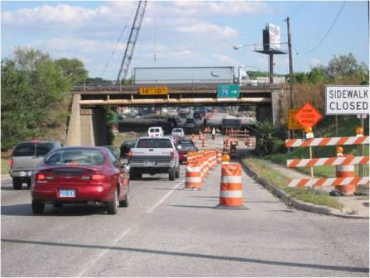
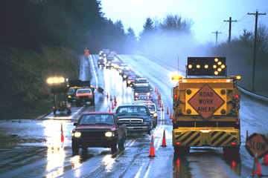
Work Zone Management
Several strategies and technologies available
Traveler information & portable DMS (delays, alternate routes)
Variable speed limits
Automated speed detectors, warning signs & enforcement
Dynamic lane merge system
Maintenance decision support
Demonstrated benefits include:
Reduced crashes
Reduced work zone traffic
Reduced delays
Photos: © iStockphoto.com/Trevor Smith (117812988); top inset, © iStockphoto.com/Mike Clarke (6336691); bottom inset, © iStockphoto.com/BanksPhotos (16140025)
13
Notes:
Description of the Slide
Work zone activities are a good example of the fact that every state is already performing basic elements of an operations program. This program may for years have been labeled “maintenance.” But how it’s done today is a true measure of how improved operations thinking is taking root. For example, many of these maintenance activities are now completed during off-peak hours because of their impact on the traveling public.
Key Points
Working at off peak periods and the use of cones, barrels, arrow signs and related equipment is just the beginning of the operations concept as applied to work zone activities.
Work zone management may be one of the most visible activities that a DOT does; and your performance in terms of providing up-to-date relevant information, keeping traffic moving, and minimizing backups is judged every day. Of course, the safety of the workers and of the drivers travelling through the work zone is also of primary importance.
Proactively applying operations strategies such as traveler information on delays and alternate routes, variable speed limits and warning signs, and lane merge systems to work zone management activities can result in significant benefits.
These benefits may include reduced crashes in and along the approaches to the work zones, reduced traffic through the work zone, and reduced delays by using alternative routes an modes.
Other - Perhaps provide a local / near-by example of the benefits. Information in this regard is available at http://www.itsbenefits.its.dot.gov/
SLIDE 14: Work Zone Management

Slide 15
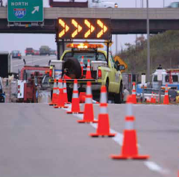
Traffic Incident Management (TIM)
Planned and coordinated process to detect, respond and clear incidents and crashes quickly and safely
Multi-disciplinary activity involving DOTs & emergency service providers
TIM reduces the duration of traffic incidents (30-50%)
Reduces congestion
Improves reliability
Improves safety - reduces secondary crashes
20
Notes:
Description of the Slide
Traffic Incident Management (TIM) is defined as the systematic, planned, and coordinated use of human, institutional, and technical resources to reduce the duration and impact of incidents, and improve the safety of motorists, crash victims, and incident responders.
Key Points
By systematically reducing the time to detect an incident (such as a crash); implement the appropriate response; and safely clear the incident, while managing the affected flow until full capacity is restored, TIM increases the operating efficiency, safety, and mobility of the transportation network.
Successful traffic incident management requires a multi-disciplinary and multi-agency approach. It helps develop strong partnerships across multiple departments within the agency, and also between transportation and enforcement agencies, fire and rescue, emergency medical services, towing services, and environmental agencies in both rural and urban areas.
Traffic incident management has proven time and again to be one of the easiest and most direct paths to significant reduction in delay, an improvement in travel time reliability, and improving the standing of DOT with its customers
Other - Perhaps mention the SHRP2 National Traffic Incident Management Responder Training program, which is building a cadre of well-trained responders who can work together as a team in a coordinated manner.
Perhaps provide a local / near-by example of the benefits. Information in this regard is available at http://www.itsbenefits.its.dot.gov/
SLIDE 15: Traffic Incident Management (TIM)

Slide 16
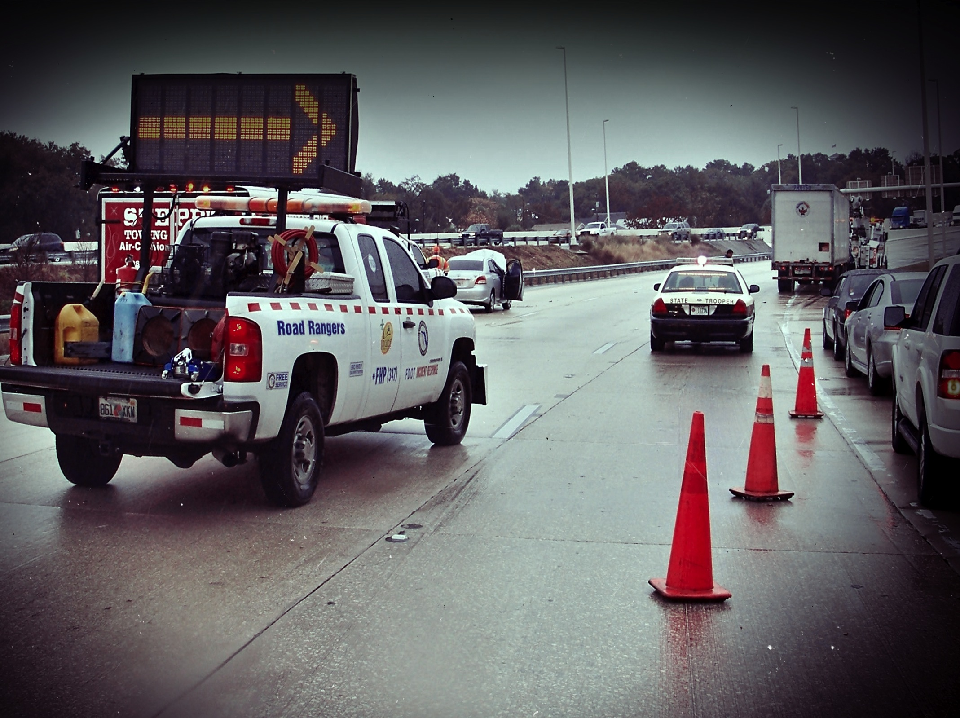
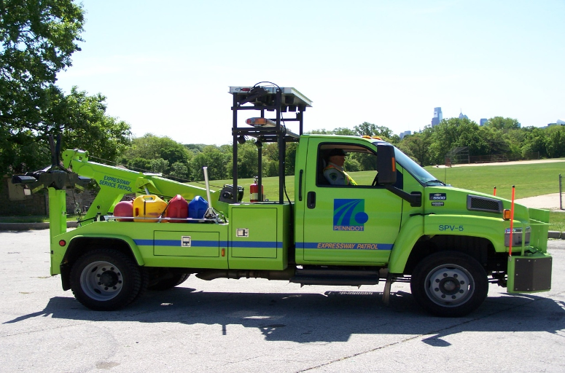
Safety Service Patrols and Incident Response Trucks
Part of TIM Program
Specially equipped response trucks and trained operators
Assist stranded motorists and clearing debris
Provide traffic control during traffic incidents
Example Benefits
Cleared 80% of incidents within 10 minutes.
Average Benefit / Cost Ratio of 12.4 : 1
Favorable public response
19
Photo: Courtesy of Florida Department of Transportation
Notes:
Description of the Slide
Incident response trucks – also known as safety service patrols – are among the most visible goodwill ambassadors a DOT can have. What citizen won’t say that tax money is well spent when a service truck operator comes along to help fix a flat tire, give a couple of gallons of gas, or provide a bit of stability during an otherwise dangerous roadside stop?
Key Points
An integral part of a broader TIM program:
For addressing minor incidents such as stranded motorists and debris on the roadway,
To direct traffic around incidents, and
To provide the human touch to travelers in need.
Helping with traffic control at a crash scene also enhances safety for other responders.
Significant benefits for the dollars spent, plus the positive public relations aspect
Other - Perhaps provide a local / near-by example of the benefits. Information in this regard is available at http://www.itsbenefits.its.dot.gov/
SLIDE 16: Safety Service Patrols/ Incident Response Trucks

Slide 17
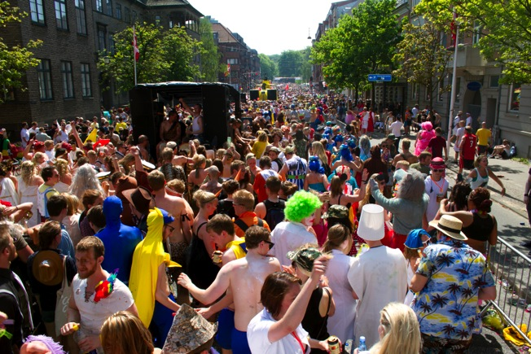
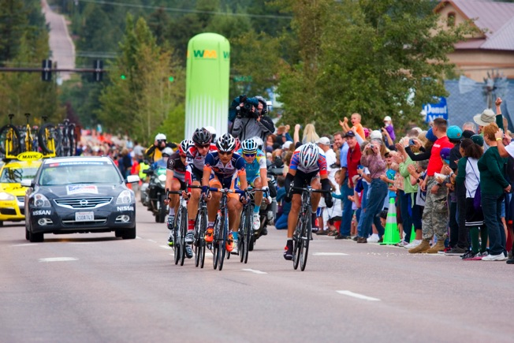
Planned Special Event Management
Effective event management requires agency collaboration and coordination
Planning and protocols
Day of event activities
Post event activities
Example Benefit:
Travel time to a major racing facility in Phoenix reduced by over 70% by applying event management strategies.
14
Notes:
Description of the Slide
Major sporting events, festivals, concerts, street fairs, and the like can be great for the regional economy; but they can also back up ramps and intersection, block lanes, and cause significant congestion. The concept of managing event traffic to minimize delay and disruption is a time-tested powerful tool that can also bring a lot of good publicity and visibility to the transportation agency.
Key Points
This is an area in which collaboration with other transportation agencies, and often including enforcement agencies and homeland security, is especially critical and the collaboration payoffs are high.
Preplanning and “day of” execution for events makes for good operations, followed by post event debriefs and lessons learned.
Effective event management – such as the benefits achieved in Phoenix – can involve the combined use of multiple operational strategies and technologies, including incident management; traveler information using radio, dynamic message signs, and mobile applications; lane control; and ramp management techniques.
Other - Perhaps provide a local / near-by example of the benefits. Information in this regard is available at http://www.itsbenefits.its.dot.gov/
SLIDE 17: Planned Special Event Management

Slide 18
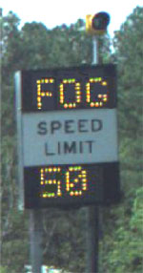
Road Weather Management
Reduce the impact of adverse weather conditions on travelers
Data collection
Data assimilation and analysis
Information dissemination
Example Benefits
Low visibility warning system.
Crash rates during fog conditions reduced 70 – 100%
Wet pavement detection & advisory system reduced crashes by 39%
B/C ratio for automated wind advisory in Oregon = 4:1 and 22:1
Notes:
Description of the Slide
Good operations mean providing the best functioning transportation network even under adverse weather conditions –scenarios that often threaten or haunt the public perception of a DOT’s performance.
Key Points
This a clear example of rural areas depending on operations just as much as do congested urban areas.
Road weather information systems have proven themselves to be very effective in reducing the variability in speeds and crashes during adverse weather conditions, be they low visibility, wet or icy pavement, or strong winds.
Road weather information systems (RWIS) include three major activities:
Collecting real-time data on roadway and atmospheric conditions
Assimilating this information with other data sources (such as weather forecasts) to determine the appropriate operational plan
Implementing the plan through information dissemination
Much, if not all of this process, can be automated
Other - Perhaps provide a local / near-by example of the benefits. Information in this regard is available at http://www.itsbenefits.its.dot.gov/ . Another source of information is http://ops.fhwa.dot.gov/weather/faq.htm
SLIDE 18: Road Weather Management

Slide 19
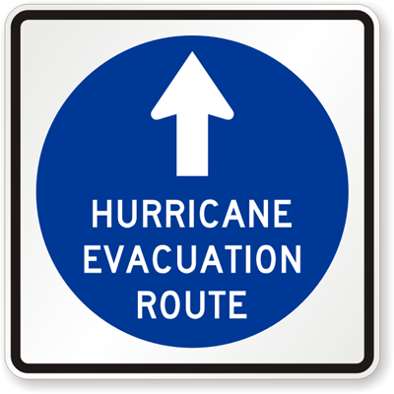
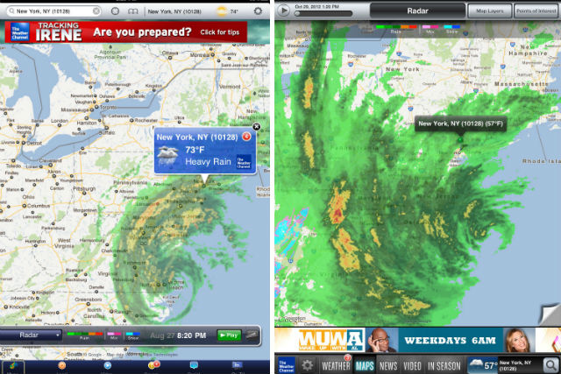
Emergency Management
Large-scale impacts
Severe weather
Homeland security
Can happen anytime, often without warning
Transportation operations is critical to effective response
Whether transportation infrastructure is affected or not
Prior, during, and following event
Multi-agency planning and coordination a must
14
Notes:
Description of the Slide
Some weather events are extreme with regional and statewide impacts, such as hurricanes, major snow events and blizzards, and flooding. Unfortunately, we also live at a time when major emergencies are often man-made, such as security threats. Operations has a role to play in the management of such emergencies.
While large-scale and catastrophic incidents are rare, it is clear that even seemingly small improvements in efficiency or effectiveness that are mastered in traditional incidents can translate into dramatic life-saving strategies when implemented in catastrophic events.
Key Points
Such emergencies have wide area impacts, and so the associated collaboration and coordination needs to be regional, state-wide, and often multi-state, involving numerous transportation and transit agencies along with enforcement entities, fire and rescue, FEMA, and homeland security, just to name a few.
The time to plan for any specific emergency, location, and duration is very limited or non-existent. It is therefore necessary to plan for several potential emergency scenarios in advance.
Whether or not segments of transportation infrastructure are directly affected, their use may still be vital.
The emergency scenarios need to address operations prior to the event (e.g., evacuations in the event of a hurricane), during the event (e.g., quick access to the impacted area by first responders and other emergency service providers), and following the event (e.g., diversions to avoid damaged or unusable segments of the transportation network, evacuated individuals getting back to their homes and work to resume some semblance of normality as quickly as possible.
SLIDE 19: Emergency Management

Slide 20
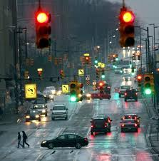
Traffic Signal Synchronization
Timing adjacent traffic signals to minimize stops
Can be based on time of day, traffic flows, special events
Example Benefits
Reductions in traffic delay ranging from 15-40%
Reductions in travel time up to 25%
Very high benefit – cost ratios, sometimes exceeding 50:1
2012 National Traffic Signal Report Card gave an overall grade of D+
16
Notes:
Description of the Slide
Poor traffic signal timing contributes to traffic congestion and delay. Conventional signal systems use pre–programmed, daily signal timing schedules. Adaptive signal control technology adjusts the timing of red, yellow and green lights in real time to accommodate changing traffic patterns and ease traffic congestion.
Key Points
Customers understand that it can be done. They are happy when they see it and grumpy when they don’t.
The improved arterial operations and benefit–cost returns in this area are very favorable. But well-synchronized signals need close attention and the ability to make dynamic adjustments.
Synchronization across jurisdiction boundaries can also be very important, but this requires collaboration to achieve integration across different hardware and software platforms.
While study after study has shown significant benefits from improved synchronization of traffic signals, there is industry-wide information indicating that we are not doing as well as we should, as demonstrated by the last National Traffic Signal Report Card (2012), which reported an overall grade of D+. This report card should give us pause. The industry is not delivering at the level it should be.
Other - Perhaps provide a local / near-by example of the benefits. Information in this regard is available at http://www.itsbenefits.its.dot.gov/
SLIDE 20: Traffic Signal Synchronization

Slide 21
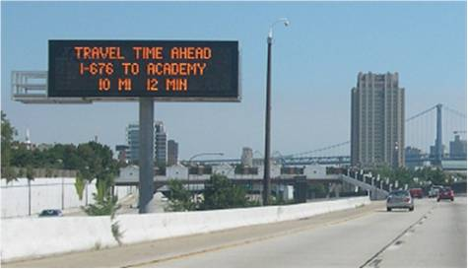
Traveler Information
511 Web and Voice
Dynamic message signs (DMS)
Radio and television traffic reports
SmartPhone apps
Social media tools
Commercial traffic condition and prediction services
Services may be provided by private sector
Example Benefits
511 customer satisfaction of 68% - 92%
Route-specific travel times: 5% -13% increase in on-time performance (i.e., reliability)
17
Notes:
Description of the Slide
Traveler information has been around for a very long time. Remember highway advisory radio and reflective flip-disc variable message signs?
The field of traveler information has evolved as newer technologies have been developed, and is now rapidly expanding with the emergence of smart phone applications, private vendors, social media, and visualization tools.
Key Points
There has been a virtual explosion in customer interest, acceptance, and expectations in the area of traveler information.
Social media and applications for mobile devices are taking over the realm of traveler information like so many communication areas
DOTs have been partnering with radio and TV traffic reports for years. Now, private vendors are seizing the opportunity.
Traveler information provides numerous benefits, and is an essential component of many other operations strategies such as incident management, special event management, variable speed limits and queue warnings as part of active traffic management and integrated corridor management for diverting traffic between parallel networks within a corridor.
Research has shown that travel information can influence not only the choice of routes but the choice of modes, which in some cases saves 20 minutes in travel time.
Other - Perhaps provide a local / near-by example of the traveler information approaches being used by the DOT.
SLIDE 21: Traveler Information

Slide 22
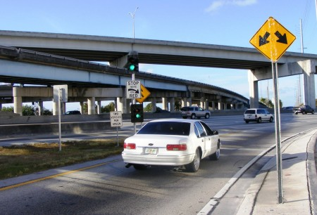
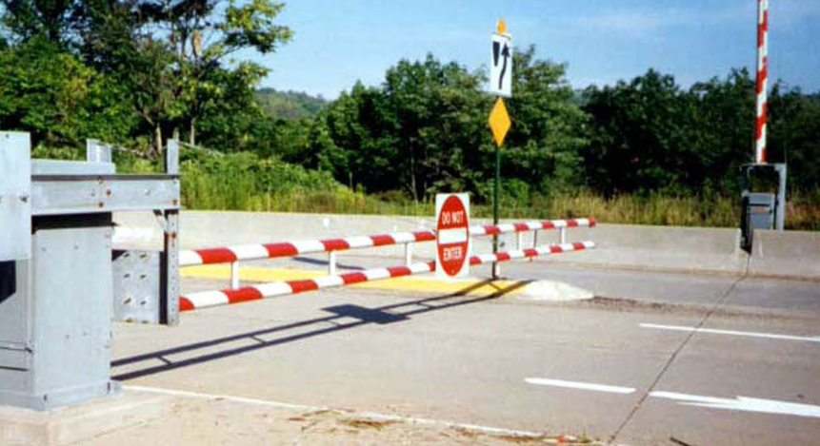
Ramp Management
Metering - traffic signals on ramps to dynamically control the rate at which vehicles enter a freeway
Smoothes the flow of traffic onto the mainline
Example Benefits
Metering increases freeway throughput 13 - 26%
Metering decreases crashes 15 - 43%
Greatest benefits occur when applied corridor-wide
18
Notes:
Description of Slide
Ramp management includes ramp metering as well as ramp closures. Ramp metering – which represents the widest application of ramp management strategies – involves the deployment of traffic signals on ramps to dynamically control the rate at which vehicles enter a freeway facility. This, in essence, smoothes the flow of traffic onto the mainline, allowing efficient use of existing freeway capacity. Ramp metering provides mobility and safety benefits.
Key Points
Ramp metering has been successfully deployed in over 20 metropolitan areas in the US, providing significant benefits in terms of reducing overall travel delays and reducing crashes, particularly those occurring in the merge and weaving areas.
The greatest benefits come with a corridor-wide implementation of metering, where the metering rates are based on real-time traffic flows along the entire stretch of the freeway, not just in the vicinity of individual ramps.
The introduction of ramp metering can be controversial; but there are approaches to minimize this potential issue, such as changing the metering rates such that ramp queues do not back up onto arterial streets, providing bypass lanes for transit and HOVs, and a public outreach program.
Other - Perhaps provide a local / near-by example of the benefits. Information in this regard is available at http://www.itsbenefits.its.dot.gov/
SLIDE 22: Ramp Management

Slide 23
Active Transportation and Demand Management (ATDM)
Broad operational philosophy – an integrated approach for dynamically and pro-actively managing and influencing travel demand and traffic flow
Uses a combination of the real-time operational strategies:
Those previously noted
Managed Lanes
Active Traffic Management
Integrated Corridor Management
Dynamic pricing
18
Notes:
Description of the Slide
Active Transportation and Demand Management (or ATDM) is the new frontier of operations – the next step in congestion management. ATDM is not a specific operational strategy, but a broad operational philosophy incorporating an integrated approach for dynamically and pro-actively managing and influencing travel demand and traffic flow.
Key Points
ATDM is a overall approach to operations, encompassing several existing and recently-introduced strategies applied in an integrated and dynamic manner. Some of the more recent operations strategies that fall under the ATDM umbrella include:
Managed Lanes, such as the High Occupancy Toll (HOT) lanes in Minneapolis – shown in the top picture – in which non-HOVs can use the designated lane by paying a toll, with the toll adjusted in real time to manage demand.
Active Traffic Management (ATM), including variable speed limits and dynamic lane assignment such as shown in the bottom picture as recently deployed in the Seattle area.
Integrated Corridor Management (ICM), which involves the operational coordination of multiple transportation networks and cross-network links within a corridor
Dynamic pricing of parking , roadways, bridges and tunnels.
ATDM is not some future vision. These strategies are being deployed in Europe and the United States with substantial benefits in terms of safety, mobility, and reliability.
Other - If desired (e.g., the DOT is specifically interested or is pursuing some of these advance operations strategies), individual slides on Managed Lanes, ATM and ICM are provided in the parking lot at the end of the presentation. Additional information on ATDM may be obtained at: http://ops.fhwa.dot.gov/atdm/about/index.htm
SLIDE 23: Active Transportation and Demand Management (ATDM)

Slide 24
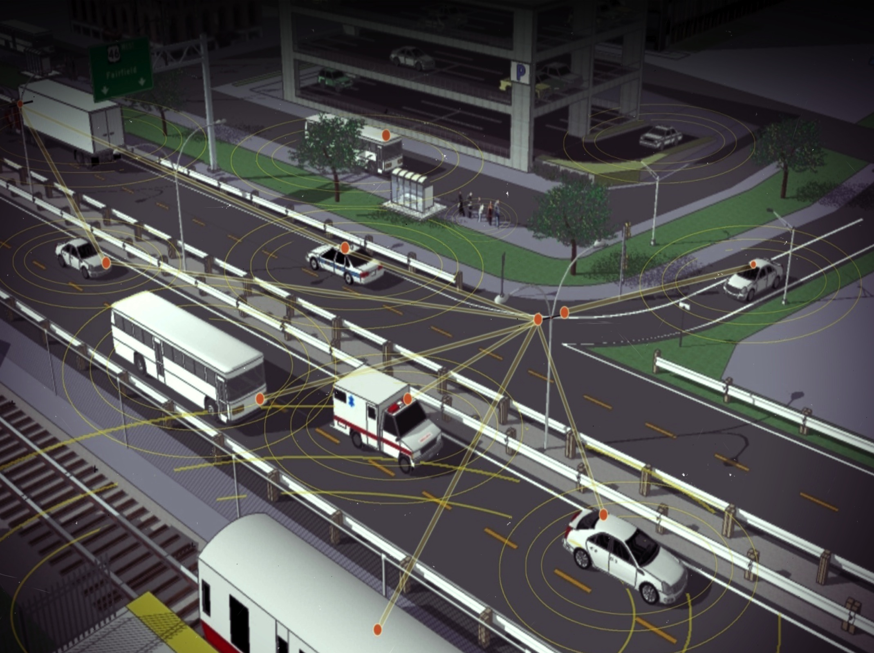
Connected Vehicles and the Future
Vehicles “reading” the roadway and one another
Collisions reduced; reliability improved
Smarter operational decisions (possibly predictive)
The Future?
Technology transformation changes mobility
What might be the impact of autonomous vehicles?
DOT role in supporting development
Image: Michigan Department of Transportation, Connected Vehicle Update, October 2011, Vol. 4, No. 1, courtesy of U.S. Department of Transportation
21
Notes:
Description of the Slide
“Connected vehicles” is a program focusing on technologies that makes vehicles aware of one another as well as of important roadway features so they can work together to avoid crashes and improve traffic flow.
Key Points
This is the new frontier where the Internet and wireless technologies will have major transformative effects in how traffic operates and the associated mobility and safety issues.
Connected Vehicles provide the capability to identify threats and hazards on the roadway, including other vehicles, and communicate this information over wireless networks to give drivers alerts and warnings.
This connectivity offers the opportunity to know much more about traffic and roadway conditions than ever before. This information could lead to improved traffic signal control, ubiquitous traveler information, better transportation planning, and reduced cost for existing transportation data collection methods,
It may enable a paradigm shift in the way DOTs leverage resources into better maintenance and asset management practices.
This is a “frontier” that is not very far away in time. Many connected vehicle components are already being tested and implemented.
Transportation agencies should be aggressive in preparing for the Connected Vehicle future, as well as for the next potential future of automated vehicles.
Other -Additional information may be obtained at http://www.its.dot.gov/connected_vehicle/connected_vehicle.htm
SLIDE 24: Connected Vehicles and the Future

Slide 25
Reaching Full Potential of Operations
Full potential is not primarily a “technology” issue or knowledge of best operations practices
The key: Put in place and manage specific supportive business and technical processes and supporting institutional arrangements
“Mainstreaming Operations”
Necessary at agency & regional level – Per MAP 21: State DOTs and MPOs must consider projects and strategies as part of their planning process that promote efficient operations
Notes:
Description of the Slide
Reaching the full potential for operations is more than having an understanding of various operations strategies and supporting technologies, or implementing a number of often disparate ITS-related projects. Operations needs to become a formal core function of the DOT in the same manner that construction and maintenance activities currently are.
Key Points
The key to having a successful operations environment is to integrate or “mainstream” operations strategies into the agency’s institutional framework and corresponding business processes.
In order for this to happen, planning, funding, design, contracting and implementation, and on-going management must consider and include operations in daily activities across all divisions of the agency, and at all stages of the process.
This mainstreaming is also necessary at the regional level with operations being an integral part of the formal transportation planning and congestion management planning processes.
MAP 21 requires this agency and regional integration of operations into the planning processes
SLIDE 25: Reaching Full Potential of Operations

Slide 26
Key Leadership Questions for Mainstreaming Operations
What are your customers’ needs and expectations?
What are your current business processes for operations (e.g., who is responsible)?
Where are you today?
Where do you want and need to go?
How are you going to get there?
Each DOT will have unique challenges and opportunities
23
Notes:
Description of the Slide
To mainstream operations and enhance the contribution of operations to your organization, you must address five basic questions as matters of executive leadership.
Key Points
The five basic questions:
What are your customer’s expectations?
Who is responsible for managing operations?
Where are you today?
Where do you want to go?
How are you going to get there?
The answer to the last questions involves identifying:
What areas should this DOT target for improvement, and
Which capabilities does the DOT have to improve to get there
Once you have the answers to these questions, you can then develop a plan for continuous improvement and moving from where you currently are to where you want and need to be.
Every state DOT will have its own unique mix of needs and opportunities for its operations program that makes sense for that particular state. No matter how good you are, you can always improve.
This may not always be simple to do; but it will be a very rewarding investment of your leadership time and energy.
SLIDE 26: Key Leadership Questions for Mainstreaming Operations

Slide 27
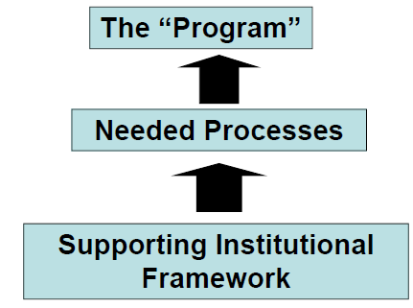
Mainstreaming Operations
Consider organizational issues and relationships
Focus on supporting business and technical processes within the agency
Define what constitutes an effective program
Mutual Benefits – Including operations in the Highway Safety improvement Program, Congestion Management Process, Asset Management Plan, etc.
Notes:
Description of the Slide
Mainstreaming operations is all about developing and putting into place a supportive institutional framework and organization that leads to the establishment of business and technical processes to create an effective and sustainable operations program
Key Points
This is all about continuous improvement in the operation of the transportation network.
It requires an assessment of organizational issues, and putting into place the supporting business and technical processes within the agency
It also requires performance measures and metrics to gauge just how well you are doing.
This is not done in a vacuum; the operations program should be integrated with other programs such as the congestion management process and asset management (for example, of the supporting ITS hardware and software)
SLIDE 27: Mainstreaming Operations

Slide 28
Critical Dimensions for Improved Operations in a DOT
Business Processes
Systems & Technology
Performance
Culture
Organization / Staffing
Collaboration
All (6) dimensions are:
Essential
Interrelated
Requires executive support and leadership
Objective is continuous improvement of operations and reliability
24
Photo: © iStockphoto.com/Johnny Greig (19953920)
Notes:
Description of the Slide
The SHRP2 L01 and L06 products provide a formal procedure to integrate and mainstream operations into an agency’s program. These products focus on orienting and improving key business processes within the agency in order to facilitate effective management and operations programs and projects.
Key Points
Six dimensions of organizational capability have been identified:
Business Processes – formal scoping, planning and programming, and budgeting
Systems and Technology – use of systems engineering, systems architectures, standards (and standardization) and interoperability
Performance – defining measures, data acquisition and analytics, and utilization
Culture – understanding, leadership, outreach, and program legal authority
Organization / Staffing – programmatic status, organizational structure, staff development, recruitment and retention
Collaboration – relationships and partnering among levels of government and with public safety agencies, local governments, MPOs and the private sector
These six dimensions are interrelated, supporting one another.
Continuous improvement cannot happen without executive support and leadership.
Other - The next two slides define and list the components and activities identified for the six dimensions in the key points (sub-bullets) above. If these next two slides are used, it is not necessary to identify these components and activities as part of this slide; just to mention that six interrelated dimensions have been identified for mainstreaming operations into the institutional framework.
SLIDE 28: Critical Dimensions for Improved Operations in a DOT

Slide 29
Operations Capability Dimensions
Business Processes
Planning and programming
Budgeting (resources)
Performance
Defining measures
Data acquisition and analytics
Presentation (internal and external)
Systems and Technology
Use of systems engineering
Systems architectures
Standards and interoperability
Notes:
Description of the Slide
Identifies some of the key components and activities associated with the dimensions of Business Processes, Performance, and Systems and Technology
Key Points
Business Processes – planning and programming, budgeting (resources), and project scoping
Performance – defining measures, data acquisition and analytics, and utilization including presentation of the results
Systems and Technology – use of systems engineering, systems architectures, standards (and standardization) and interoperability
SLIDE 29: Operations Capability Dimensions

Slide 30
Operations Capability Dimensions (cont.)
Culture
Leadership
Outreach
Program legal authority
Technical understanding
Organization / Staffing
Programmatic status
Organizational structure
Staff development and retention
Collaboration
Relationships and partnering:
Within DOT
Among levels of government
Public safety agencies
MPOs
Private sector
Notes:
Description of the Slide
Identifies some of the key components and activities associated with the dimensions of Culture, Organization and Staffing, and Collaboration
Key Points
Culture – technical understanding, leadership, outreach, and program legal authority
Organization / Staffing – programmatic status, organizational structure, staff development, recruitment and retention
Collaboration – relationships and partnering among levels of government and with public safety agencies, local governments, MPOs and the private sector
SLIDE 30: Operations Capability Dimensions (cont.)

Slide 31
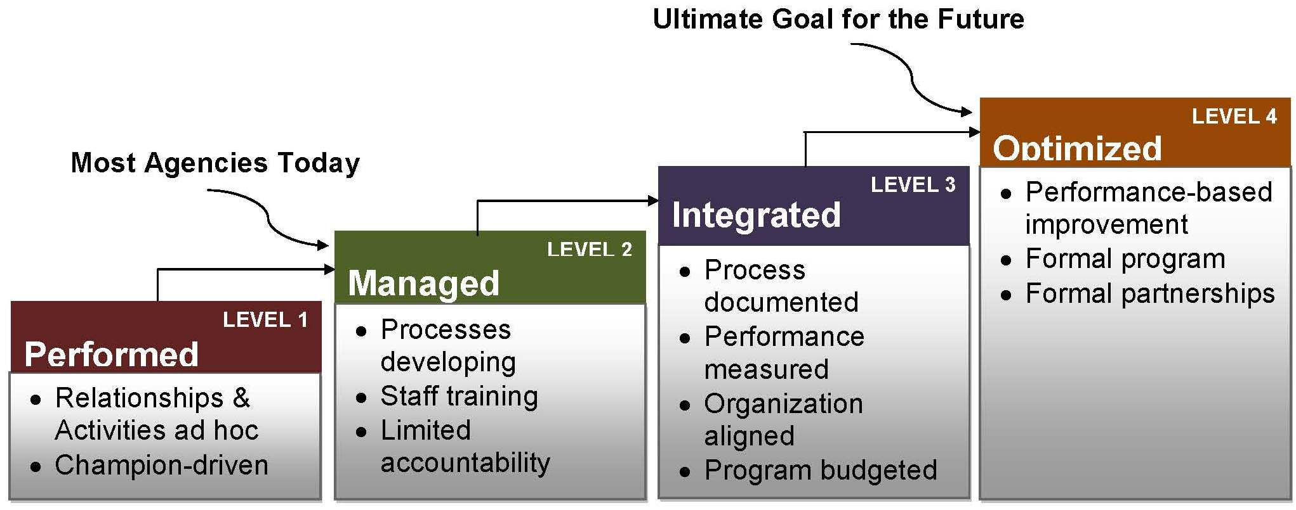
Levels of Capability Maturity
Notes:
Description of the Slide
For each of these six dimensions, four levels of maturity have been defined – where the term “maturity” is related to the degree of formality and optimization of these processes in support of effective operations.
Key Points
Level 1: Performed – Activities and relationships largely ad hoc, informal and champion-driven – substantially outside the mainstream of other activities within the transportation agency.
Level 2: Managed – Basic strategy applications understood; key processes and support requirements identified; key technology and core capacities under development; but limited internal accountability and uneven alignment with external partners. This is where most DOTs are today.
Level 3: Integrated – Standardized strategy applications implemented in priority contexts and managed for performance; operations-related technical and business processes developed, documented, and integrated into the agency and the regional transportation planning process; partnerships aligned.
Level 4: Optimized – This represents the ultimate goal, in which operations is addressed as a full, sustainable core agency program, established on the basis of continuous improvement with top level management status; part of the region-wide program and planning process with formal partnerships will all involved agencies.
SLIDE 31: Levels of Capability Maturity

Slide 32
Regional Operations Collaboration
“Planning for Operations”
Multi-modal collaboration between agencies and jurisdictions
Collaboration between planners and operators
Focus on specific outcomes and regional objectives
Prioritize investments to achieve operations objectives
Demonstrate accountability through performance measures
“Objectives-Driven Performance Based Approach”
Notes:
Description of the Slide
Much of the discussion has focused on mainstreaming operations into an individual agency such as a DOT. But to achieve continuous improvement and to get your agency’s operations program and projects funded, the mainstreaming effort must also address regional planning processes and multi-agency collaboration.
Key Points
The FHWA refers to this a “planning for operations” – a joint effort between planners and operators to support improved regional transportation system management and operations. It involves the consideration of operations strategies in regional transportation planning – including the integration of operations strategies in the metropolitan transportation plan.
It requires coordination and collaboration between a number of regional partners, including planning staff and operations staff from metropolitan planning organizations (MPOs), State Departments of Transportation, transit agencies, highway agencies, toll authorities, and local governments.
The approach to planning for operations is objectives-driven and performance-based. Rather than focusing on projects and investment plans, planning for operations means first developing objectives for transportation system performance, and using outcome-based performance measures and targets as a basis for identifying solutions and developing investment strategies to achieve the operational objectives.
These same performance measures are used to evaluate how well the strategies are working, make adjustments as may be appropriate, and demonstrate accountability
SLIDE 32: Operations Collaboration for a Region

Slide 33
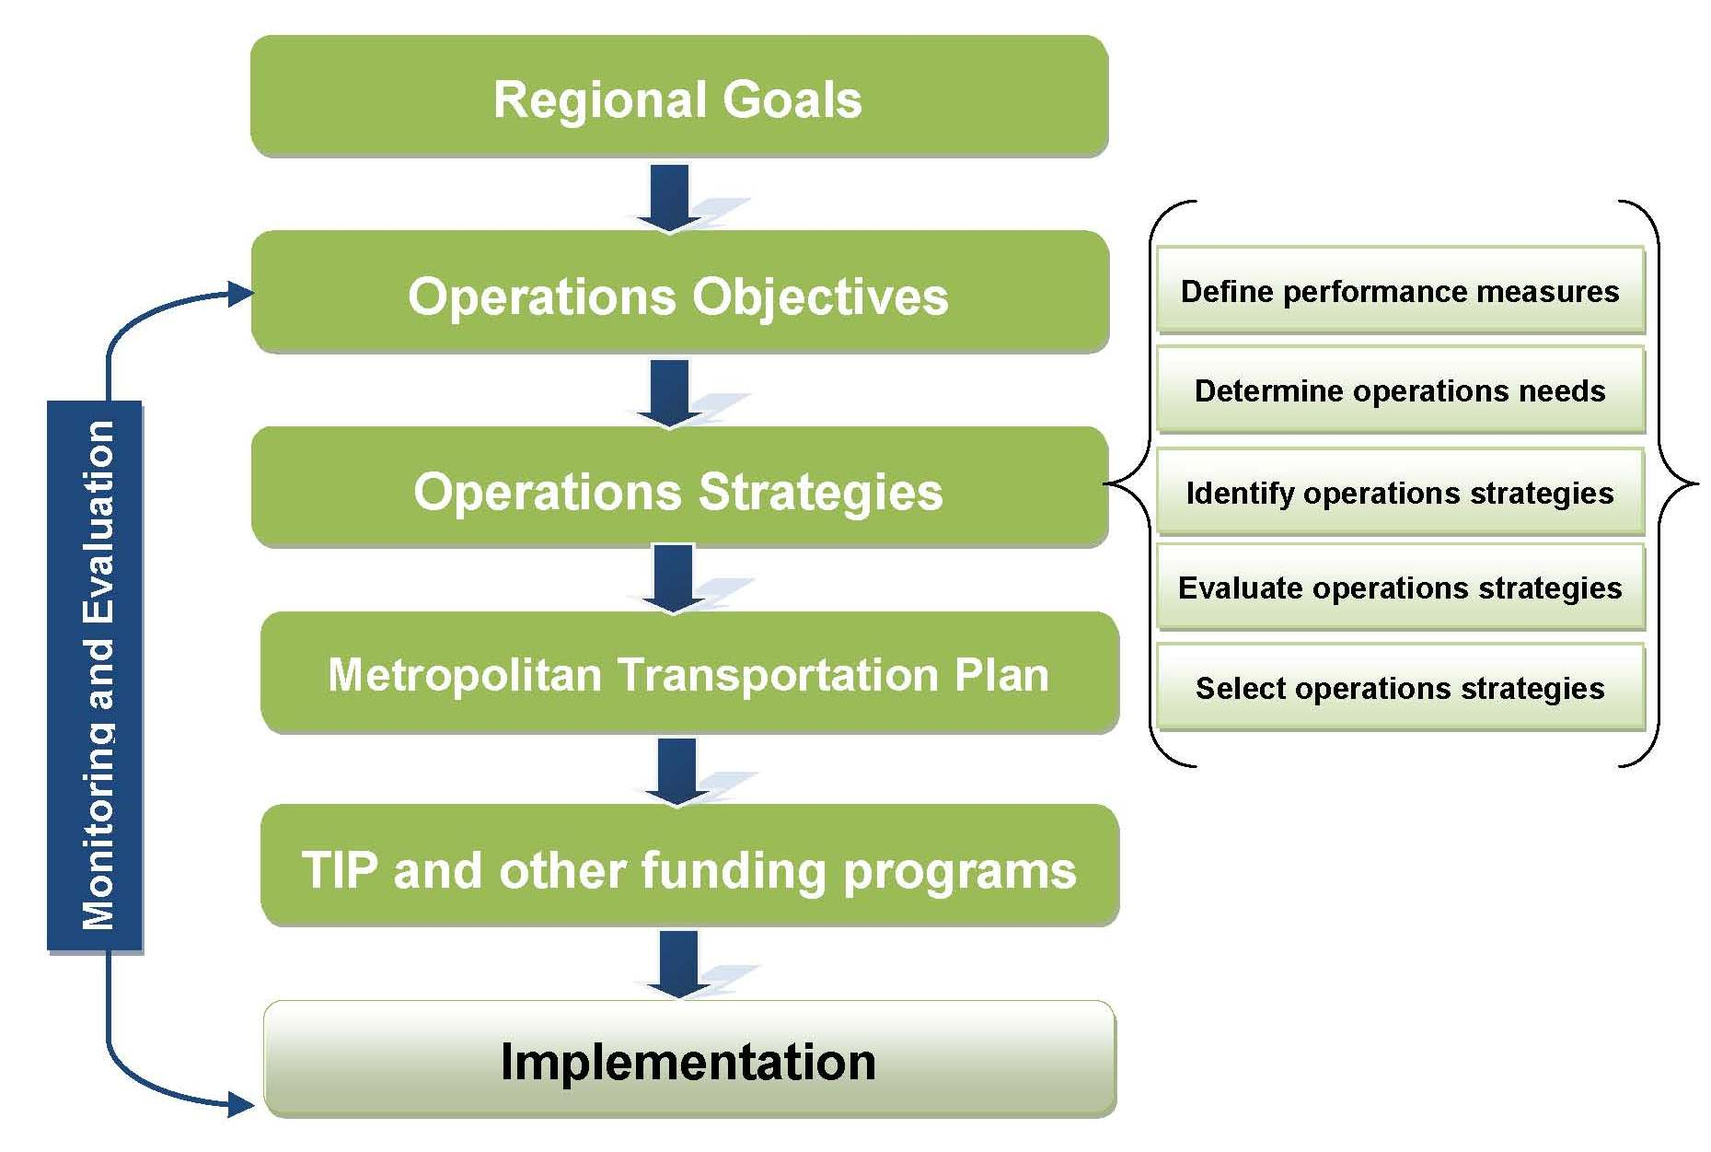
Objectives – Driven Performance Based Approach
Notes:
Description of the Slide
This shows an objectives-driven based approach. Traditionally, transportation planning and transportation system operations have been largely separate, independent activities.
Planners focused on long-range transportation investments, including development of metropolitan transportation plans and programming of projects.
Operators were concerned with addressing immediate system needs—incident response, traffic control, traveler information, and work zone management.
Planning for operations and the objectives-driven approach connects these two vital components of transportation, and integrates operations considerations into the planning process.
Key Points
Regional goals form the basis for developing operational objectives
A systematic process is used for developing and selecting operations strategies based on needs (as can be identified from the Congestion Management Plan), performance measures, and an evaluation of the candidate strategies
The selected operations strategies are included in the Metropolitan Transportation Plans and TIP
This leads to the implementation of the operations strategies and supporting technologies and staffing. Implementation is a crucial part of achieving the objectives.
SLIDE 33: Objectives-Driven Performance Based Approach

Slide 34
Summary
Operations is a critical component for managing the transportation network on a daily basis.
Preserve and maximize existing capacity
Enhance mobility, reliability, safety, and environment
Provide customer service via a performance-based approach
Achieve quick and cost-effective implementation
To be successful, operations need to be “mainstreamed” into the agency's institutional and organizational framework.
You have an important role to play in this regard.
Notes:
Description of the Slide
This slide summarizes the key points from the previous slides and discussions.
Key Points
Operations is a critical component for actively managing the transportation network on a daily basis, providing several benefits to a DOT including:
Preserve and maximize existing capacity
Enhance mobility, reliability, safety, and the environment
Provide customer service via a performance-based approach
Achieve quick and cost-effective implementation (with large benefit – cost ratios
To be successful, operations needs to be “mainstreamed” into the agency's institutional and organizational framework.
Such change and adaptation cannot be achieved without your enthusiasm and leadership.
SLIDE 34: Summary

Slide 35
Next Steps
Demonstrate commitment and involvement at the top level.
Empower the people who can make it happen and give them the resources they need.
Provide top-down direction and insist on bottom-up accountability.
If you need assistance – Contact:
FHWA: Steve Clinger (Stephen.Clinger@dot.gov)
AASHTO: Gummada Murthy (gmurthy@aashto.org)
Notes:
Description of the Slide
As a DOT CEO or senior manager, the ball is in your court:
Demonstrate your own commitment.
Empower the people on your team who you will rely on for results.
Provide top direction and insist on accountability.
Key Points
Get engaged and develop champions within your organization, and provide them with the necessary resources to help make this happen.
Feel free to contact FHWA or AASHTO at any time if you have any questions or need additional assistance.
Other – The specific names and contact information for FHWA may be changed or additional names listed depending on the DOT / agency for whom the presentation is being given.
SLIDE 35:Next Steps

Slide 36
Questions
Notes:
Description of the Slide
Solicit and respond to questions and comments
Key Points
Make sure to follow up to any questions that can’t be answered immediately, and to requests for any additional information.
SLIDE 36:Questions

Slide 37
ADDITIONAL SLIDES AS APPROPRIATE
Notes:
This is a “parking lot” for slides providing additional details on selected areas and operations strategies. These may be included in the presentation as indicated in the “Other” notes for previous slides.

Slide 38
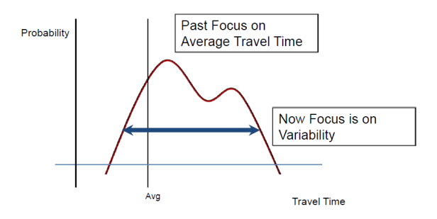
What is “Reliability”?
Consistency or dependability in travel times
As measured from day to day, or across different times of day
Less tolerance for unexpected delays
Planning for travel variability has costs for users, including individuals, transit operators, freight and their end users
Notes:
Description of the Slide
What we mean by reliability – is the ability for travelers and transporters to depend on getting from point a to b in an expected amount of time. The more reliable a route is the less tolerance is given for unexpected delays. If we can decrease the opportunities for delay we can decrease the need to budget for variable travel delays thereby saving money for travelers, transit operators, freight transporters and their end users.
Key Points
Reliability focuses on the consistency of travel times.
The past focus was on average travel times; reliability is concerned with the variability of individual travel times from day to day.
Optimal operations fine tunes travel reliability on the system and reduces amounts of unexpected delays.
Less need to budget in time and money for “inevitable” travel delays saves money for users and end users.
SLIDE: “What is “Reliability”

Slide 39
Managed Lanes
Lane(s) where use is based on:
Vehicle type / eligibility
Pricing
Access control
Examples:
HOV lanes
HOT lanes
Bus-only lanes
Express toll lanes
Demand and capacity managed on a pro-active basis
Price
Eligibility requirements
In Minneapolis (HOV lanes converted to HOT lanes)
Peak period throughput increased 9-33%
Mainline crashes reduced 5.3%
Photos: © iStockphoto.com/Mark Hatfield (137316743); left and top right insets, courtesy of Florida Department of Transportation; bottom right inset, courtesy of Washington State Department of Transportation
18
Notes:
Description of the Slide
Managed Lanes are defined as highway facilities or a set of lanes where operational strategies are proactively implemented and managed in response to changing conditions. Managed Lanes are based upon flexible operating strategies and active management of the transportation system.
Key Points
The managed lane concept is typically a "freeway-within-a-freeway" where a set of lanes within the freeway cross section is separated from the general-purpose lanes.
The principal management strategies can be categorized into three groups: vehicle eligibility, pricing and access control.
Demand and available capacity of the managed lane is pro-actively managed based on changes in price and eligibility requirements
Other - Additional information can be obtained at http://ops.fhwa.dot.gov/freewaymgmt/mngd_lns_hov.htm
SLIDE: Managed Lanes

Slide 40
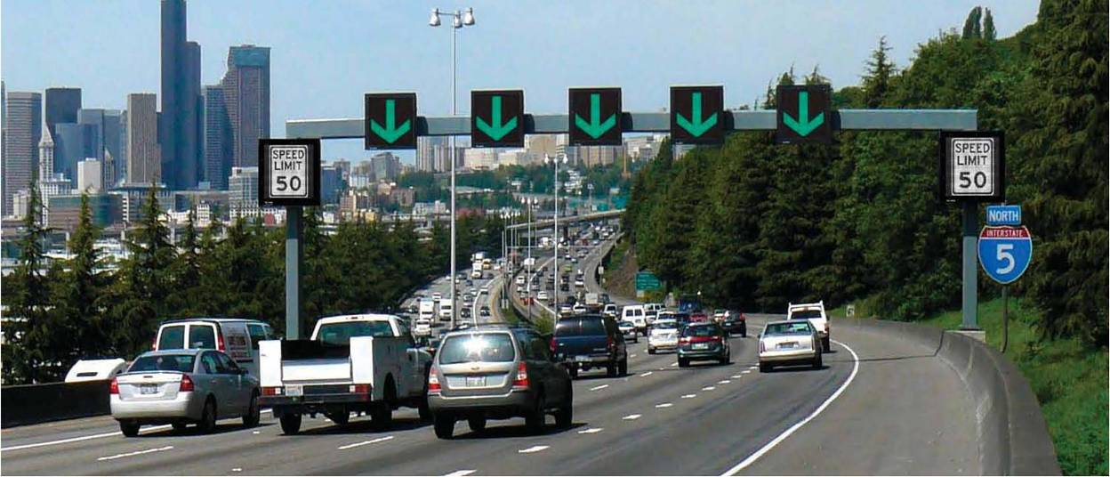
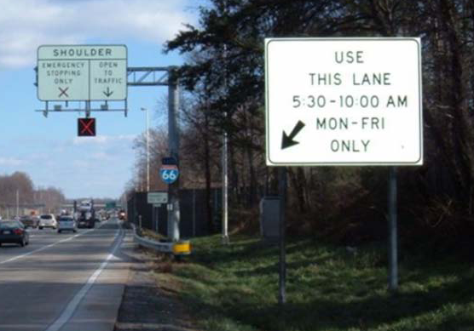
Active Traffic Management (ATM)
Dynamically manage congestion based on prevailing traffic conditions
Variable speed displays
Dynamic lane control
Queue warning
Hard shoulder running
Relatively new to US -
European Experience
Throughput increased by 3–7%
Decrease in incidents of 3–30%
Emissions decreased 2-8%
Benefit/Cost ratio of 3.9 : 1
18
Notes:
Description of the Slide
The two fundamental concepts of ATM are active management of the capacity and direct interaction with drivers to encourage them to make tactical driving decisions (e.g., stopping, slowing down, and changing lanes).
Key Points
Active traffic management includes several strategies that are often deployed and integrated together, including:
Variable Speed Displays : This strategy adjusts speed limits based on real-time traffic, roadway, and/or weather conditions. Dynamic speed limits can either be enforceable (regulatory) speed limits or recommended speed advisories
Dynamic Lane Control: This strategy involves dynamically closing or opening of individual traffic lanes as warranted and providing advance warning of the closure(s) in order to safely merge traffic into adjoining lanes.
Queue warning: This strategy involves real-time displays of warning messages to alert motorists that queues or major slowdowns are ahead, thus reducing rear-end crashes
Dynamic Hard Shoulder Running: This strategy enables the use of the shoulder as a travel lane(s) based on congestion levels during peak periods and in response to incidents or other conditions as warranted during non-peak periods.
ATM strategies have been widely used in Europe with very positive results. The initial deployments of ATM in the US – in Seattle and Minneapolis – have also shown positive benefits, such as:
11% reduction in crashes for the Seattle system
9 % reduction for fatal plus injury crashes, and greater than 20 % reduction for property damage only (PDO) and total crashes in Minneapolis
In both cases, the roadway segments were already actively managed and operated via robust incident management, traveler information, and ramp metering programs.
SLIDE: Active Traffic Management (ATM)

Slide 41
Integrated Corridor Management
City 1
City 1
–
–
Traffic Signal System
Corridors offer opportunities to optimize the entire system
ICM is the operational coordination of multiple transportation networks and cross-network links
Integrated traveler info
Operational efficiency of network junctions
Cross-network route & modal shifts
Capacity and demand
Traffic Signal System
P
P
Regional Rail Agency
Regional Rail Agency
–
–
Train Management System
Train Management System
State DOT
State DOT
–
–
Freeway Management System
Freeway Management System
Bus Company
Bus Company
–
–
AVL system
AVL system
City 2
City 2
–
–
Traffic Signal System
Traffic Signal System
Example Benefits
ICM along I-15 in San Diego: estimated B/C ratio of 9.7:1
Simulation of ICM: B/C ratios of 7.1:1 to 25.1:1
Notes:
Description of the Slide
Integrated Corridor Management (ICM) consists of the operational coordination of multiple transportation networks and cross-network connections comprising a corridor, and the coordination of institutions responsible for corridor mobility.
Key Points
Corridors, consisting of parallel roadway networks and modes, offer an opportunity to operate and optimize the entire system as opposed to the individual networks.
Several ICM approaches exist, consisting of the integrated management of multiple operations strategies across the shoulder. Basic approaches include:
Integrated traveler information
Improve Operational Efficiency of Network Junctions: such as signal priority for transit, multi-modal electronic payment, transit hub connection protection
Accommodate / Promote Cross-Network Route and Modal Shifts; such as modify arterial signal timing to better accommodate traffic diverting from freeway, modifying transit priority parameters to accommodate more timely bus operation, promoting route shifts between roadways and modal shifts (from roadway to transit) via traveler information
Manage Capacity – Demand Relationship within Corridor such as dynamic lane use control (including reversible lanes / contra-flow) and variable speed limits via ATM), convert regular lanes (and / or shoulders) to transit only or emergency only, add transit capacity by adjusting headways / additional vehicles, add capacity at parking lots (temporary lots), increase roadway capacity by opening HOV / HOT lanes / shoulders, restrict ramp access, modify toll / HOT pricing.
SLIDE: Integrated Corridor Management

